Slide 1
BLOCK DRIVERS
Ted Baker • Andy Wang
CIS 4930 / COP 5641

Slide 2
TOPICS
Block drivers
Registration
Block device operations
Request processing
Other details

Slide 3
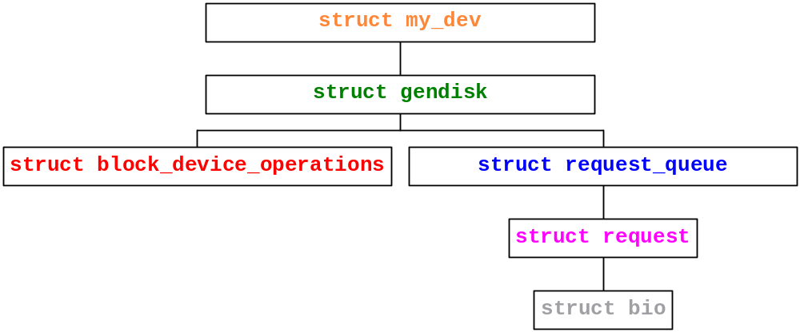
OVERVIEW OF DATA STRUCTURES

Slide 4
BLOCK DRIVERS
Provides access to devices that transfer randomly accessible data in blocks, or fixed size chunks of data (e.g., 4KB)
  Note that underlying HW uses sectors (e.g., 512B)
Bridge core memory and secondary storage
  Performance is essential
  Or the system cannot perform well
Lecture example: sbd (Simple Block Device)
  A ramdisk
  http://blog.superpat.com/2010/05/04/a-simple-block-driver-for-linux-kernel-2-6-31/

Slide 5
BLOCK DRIVER REGISTRATION
To register a block device, call
int register_blkdev(unsigned int major,
const char *name);
  major: major device number
    If 0, kernel will allocate and return a new major number
  name: as displayed in /proc/devices
To unregister, call
int unregister_blkdev(unsigned int major,
const char *name);

Slide 6
DISK REGISTRATION
register_blkdev
  Obtains a major number
  Does not make disk drives available to the system
Need additional mechanisms to register a disk
  Need to know two data structures:
    struct block_device_operations
      Defined in <linux/blkdev.h>
    struct gendisk
      Defined in <linux/genhd.h>

Slide 7
BLOCK DEVICE OPERATIONS
struct block_device_operations is similar to file_operations
Important fields
  /* may need to lock the door for removal media; unlock in the release method; may need to spin the disk up or down */
  int (*open) (struct block_device *dev,
  fmode_t mode);
  int (*release) (struct gendisk *gd,
  fmode_t mode);

Slide 8
BLOCK DEVICE OPERATIONS
  int (*ioctl) (struct block_dev *bdev,
  fmode_t mode,
  unsigned int cmd,
  unsigned long long arg);
  /* check whether the media has been changed; gendisk represents a disk */
  int (*media_changed) (struct gendisk *gd);
  /* makes new media ready to use */
  int (*revalidate_disk) (struct gendisk *gd);

Slide 9
BLOCK DEVICE OPERATIONS
  int (*getgeo) (struct block_device *bdev,
  struct hd_geometry);
  struct module *owner; /* = THIS_MODULE */

Slide 10
BLOCK DEVICE OPERATIONS
Note that no read and write operations
Reads and writes are handled by the request function
  Will be discussed later

Slide 11
THE GENDISK STRUCTURE
struct gendisk represents a disk or a partition
Must initialize the following fields
  int major;
  int first_minor;
  /* need one minor number per partition */
  int minors;
  /* as shown in /proc/partitions & sysfs */
  char disk_name[32];

Slide 12
THE GENDISK STRUCTURE
  struct block_device_operations *fops;
  /* holds I/O requests for this device */
  struct request_queue *queue;
  /* set to GENHD_FL_REMOVABLE for removal media; GENGH_FL_CD for CD-ROMs */
  int flags;
  /* in 512B sectors; use set_capacity() */
  sector_t capacity;

Slide 13
THE GENDISK STRUCTURE
  /* pointer to internal data */
  void *private data;

Slide 14
THE GENDISK STRUCTURE
To allocate, call
  struct gendisk *alloc_disk(int minors);
    minors: number of minor numbers for this disk; cannot be changed later
To deallocate, call
  void del_gendisk(struct gendisk *gd);
To make disk available to the system, call
  void add_disk(struct gendisk *gd);
To make disk unavailable, call
  void put_disk(struct gendisk *gd);

Slide 15
INITIALIZATION IN SBD
Allocate a major device number
...
major_num
= register_blkdev(major_num, "sbd");
if (major_num <= 0) {
/* error handling */
}
...

Slide 16
SBD DATA STRUCTURE
struct sbd_device {
int size; /* device size in sectors */
u8 *data;
spinlock_t lock;
struct gendisk *gd;
} Device;

Slide 17
SBD DATA STRUCTURE INITIALIZATION
...
spin_lock_init(&Device.lock);
Device.size = nsectors*logical_block_size;
Device.data = vmalloc(Device.size);
if (Device.data == NULL) {
printk(KERN_NOTICE "vmalloc failure.\n");
return;
}
/* sbd_request is the request function */
Queue
= blk_init_queue(sbd_request, &Device.lock);
...

Slide 18
INSTALL THE GENDISK STRUCTURE
...
Device.gd = alloc_disk(16);
if (!Device.gd) {
/* error handling */
}
Device.gd->major = major_num;
Device.gd->first_minor = 0;
Device.gd->fops = &sbd_ops;
Device.gd->queue = Queue;
Device.gd->private_data = Device;
...

Slide 19
INSTALL THE GENDISK STRUCTURE
...
snprintf (Device.gd->disk_name, 32, "sbd%c", which + 'a');
set_capacity(Device.gd, nsectors*(hardsect_size/KERNEL_SECTOR_SIZE));
add_disk(Device.gd);
...

Slide 20
SUPPORTING REMOVAL MEDIA
Check to see if media has been changed, call
int sbd_media_changed(struct gendisk *gd) {
struct sbd_dev *dev = gd->private_data;
return Device.media_change;
}
Prepare the driver for the new media, call
int sbd_revalidate(struct gendisk *gd) {
struct sbd_dev *dev = gd->private_data;
if (Device.media_change) {
Device.media_change = 0;
memset(Device.data, 0, Device.size);
}
return 0;
}

Slide 21
SBD IOCTL
See drivers/block/ioctl.c for built-in commands
To support fdisk and partitions, need to implement a command to provide disk geometry information
  2.6.31 has a dedicated block device operation called getgeo, which is no longer an ioctl call

Slide 22
SBD GETGEO
int sbd_getgeo(struct block_device *bdev,
struct hd_geometry *geo) {
long size;
size = Device.size
*(logical_block_size
/ KERNEL_SECTOR_SIZE);
geo->cylinders = (size & 0x3f) >> 6;
geo->heads = 4;
geo->sectors = 16;
geo->start = 0;
return 0;
}

Slide 23
THE ANATOMY OF A REQUEST
The bio structure
  Contains everything that a block driver needs to carryout out an IO request
  Defined in <linux/bio.h>
Some important fields
  /* the first sector in this transfer */
  sector_t bi_sector;
  /* size of transfer in bytes */
  unsigned int bi_size;

Slide 24
THE ANATOMY OF A REQUEST
  /* use bio_data_dir(bio) to check the direction of IOs*/
  unsigned long bi_flags;
  /* number of segments within this bio */
  unsigned short bio_phys_segments;
  struct bio_vec {
  struct page *bv_page;
  unsigned int bv_offset; // within a page
  unsigned int bv_len; // of this transfer
  }

Slide 25
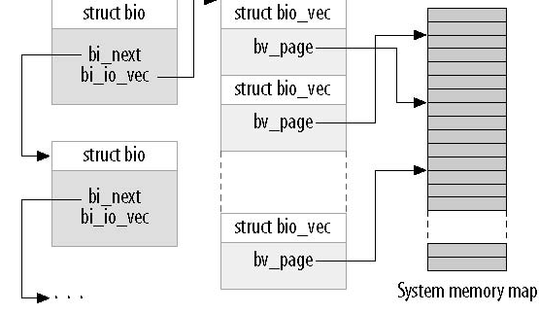
THE BIO STRUCTURE

Slide 26
THE BIO STRUCTURE
For portability, use macros to operate on bio_vec
int segno;
struct bio_vec *bvec;
bio_for_each_segment(bvec, bio, segno) {
// Do something with this segment
}
Current bio_vec entry

Slide 27
LOW-LEVEL BIO OPERATIONS
To access the pages directly, use
char *__bio_kmap_atomic(struct bio *bio,
int i,
enum km_type type);
void __bio_kunmap_atomic(char *buffer,
enum km_type type);

Slide 28
LOW-LEVEL BIO MACROS
/* returns the page to be transferred next */
struct page *bio_page(struct bio *bio);
/* returns the offset within the current page to be transferred */
int bio_offset(struct bio *bio);
/* returns a kernel logical (shifted) address pointing to the data to be transferred; the address should not be in high memory */
char *bio_data(struct bio *bio);

Slide 29
LOW-LEVEL BIO MACROS
/* returns a kernel virtual (page-table-mapped) address pointing to the data to be transferred; the address can be in either high or low memory; atomic; can only map one segment at a time */
char *bio_kmap_irq(struct bio *bio,
unsigned long *flags);
Void bio_kunmap_irq(char *buffer,
unsigned long *flags);

Slide 30
THE REQUEST STRUCTURE
A request structure is implemented as a linked list of bio structures, with some additional info
Some important fields
  /* first sector that has not been transferred */
  sector_t __sector;
  /* number of sectors yet to transfer */
  unsigned int __data_len;

Slide 31
THE REQUEST STRUCTURE
  /* linked list of bios, access via rq_for_each_bio */
  struct bio *bio;
  /* same as calling bio_data() on current bio */
  char *buffer;

Slide 32
THE REQUEST STRUCTURE
  /* number of segments after merging */
  unsigned short nr_phys_segments;
  struct list_head queuelist;

Slide 33
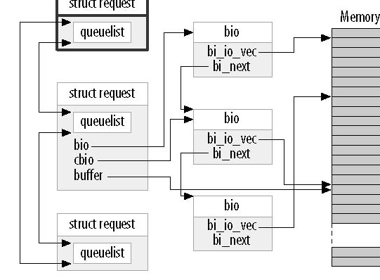
THE REQUEST STRUCTURE

Slide 34
REQUEST QUEUES
struct request_queue or request_queue_t
  Include <linux/blkdev.h>
Keep track of pending block IO requests
Create requests with proper parameters
  Maximum size, segments
  Hardware sector size
  Alignment requirement
Allow the use of multiple IO schedulers
  Maximize performance in device-specific ways
    Sort blocks
    Apply deadlines
    Merge adjacent requests

Slide 35
QUEUE CREATION AND DELETION
To create and initialize a queue, call
request_queue_t
*blk_init_queue(request_fn_proc *request,
spinlock_t *lock);
  request is the request function
  Spinlock controls the access to the queue
  Need to check out-of-memory errors
To deallocate a queue, call
void blk_cleanup_queue(request_queue_t *);

Slide 36
QUEUEING FUNCTIONS
Need to hold the queue lock
To get the reference to the next request, call
struct request *blk_fetch_request(request_queue_t *queue);
  Leave the request in the queue
To remove a request from the queue, call
void
blk_dequeue_request(struct request *req);
  Used when a driver operates on multiple requests from a queue concurrently

Slide 37
QUEUEING FUNCTIONS
To put a dequeue request back, call
void
blk_requeue_request(request_queue_t *queue,
struct request *req);

Slide 38
QUEUE CONTROL FUNCTIONS
/* if a device can handle more pending requests, call */
void blk_stop_queue(request_queue_t *queue);
/* to restart the queue, call */
void blk_start_queue(request_queue_t *queue);
/* set the highest physical address to which a device can perform DMA; the address can also be BLK_BOUNCE_HIGH, BLK_BOUNCE_ISA, or BLK_BOUNCE_ANY */
void
blk_queue_bounce_limit(request_queue_t *queue,
u64 dma_addr);

Slide 39
MORE QUEUE CONTROL FUNCTIONS
/* max in sectors */
void
blk_queue_max_sectors(request_queue_t *queue,
unsigned short max);
/* for scatter gather */
void
blk_queue_max_phys_segments(request_queue_t *queue,
unsigned short max);
void
blk_queue_max_hw_segments(request_queue_t *queue,
unsigned short max);
/* in bytes */
void
blk_queue_max_segment_size(request_queue_t *queue,
unsigned int max);

Slide 40
YET MORE QUEUE CONTROL FUNCTIONS
/* if a device cannot cross a 4MB boundary, use 0x3fffff as mask */
void
blk_queue_segment_boundary(request_queue_t *queue,
unsigned long mask);
void
blk_queue_dma_alignment(request_queue_t *queue,
int mask);

Slide 41
REQUEST COMPLETION FUNCTIONS
After a device has completed transferring the current request chunk, call
bool
__blk_end_request_cur(struct request *req,
int error);
  Indicates that the driver has finished transferring count sectors since the last time.
  Return false if all sectors in this request have been transferred and the request is complete
  Return true if there are still buffers pending

Slide 42
REQUEST PROCESSING
Every device is associated with a queue
To read or write a block device, call
void request(request_queue_t *queue);
  Runs in an atomic context
    Cannot access the current process
  May return before completing the request

Slide 43
WORKING WITH SBD BIOS
static void
sbd_request(request_queue_t *q) {
struct request *req;
req = blk_fetch_request(q);
while (req != NULL) {
/* skip non-fs request */
if (!blk_fs_request(req)) {
__blk_end_request_all(req, -EIO);
continue;
}

Slide 44
WORKING WITH SBD BIOS
sbd_transfer(&Device, blk_rq_pos(req),
blk_rq_cur_sectors(req),
req->buffer,
rq_data_dir(req));
if (!__blk_end_request_cur(req, 0)) {
req = blk_fetch_request(q)
}
}
}

Slide 45
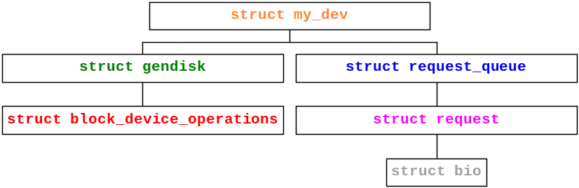
SBD_TRANSFER
static int
sbd_transfer(struct sbd_dev *dev,
sector_t sector,
unsigned long nsect, char *buffer,
int write) {
unsigned long offset
= sector * logical_block_size;
unsigned long nbytes
= nsect * logical_block size;

Slide 46
SBD_TRANSFER
if ((offset + nbytes) > dev->size) {
/* error: write beyond the limit */
return;
}
if (write)
memcpy(dev->data + offset, buffer, nbytes);
else
memcpy(buffer, dev->data + offset, nbytes);
}

Slide 47
BARRIER REQUESTS
Reordering can be problematic
  Databases must be sure that their journals are flushed to storage
Barrier requests
  If a request is marked with the REQ_HARDBARRIER flag, it must be written to the storage before the next request is initiated
    A driver needs to force HW caches to flush

Slide 48
BARRIER REQUESTS
  To indicate driver support of barrier requests, use
  void
  blk_queue_ordered(request_queue_t *queue,
  int flag,
  prepare_flush_fn *pff);
    Set the flag to nonzero
  To test this flag, call
    int blk_barrier_rq(struct request *req);
      Returns nonzero for a barrier request

